Slide 1



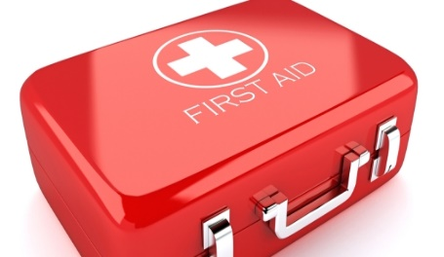
ABOUT LINK UP
LINK UP PROJECT
“Save Lives”
EMAIL: linkup127@gmail.com
MEMBERS
Akankunda Emilly
Isiagi Geoffrey
Deograceous Kaggwa
Khaukha Isaac
The Link up is youth action initiative project that is aimed at providing and promoting first aid skills through awareness and training to the youth and the public for emergency response in the various aspects of life and acquisition of life saving skills. The project is to also help the marginalized members (people with disabilities) of different communities through following;
Save Mobile
E-save (Digital Booking and Web interaction Platform)
OBJECTIVE
To increase on the first line of care to individuals by at least 75% as we administer first aid trainings for emergency response.
MISSION
“To create a pro-active youth engagement towards saving lives.”
VISION
“To be a point of reference in first aid training and promotion.”

Slide 2

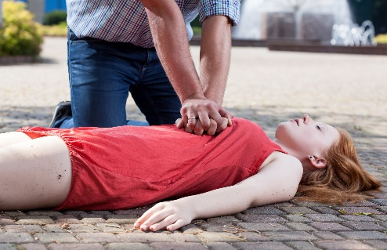

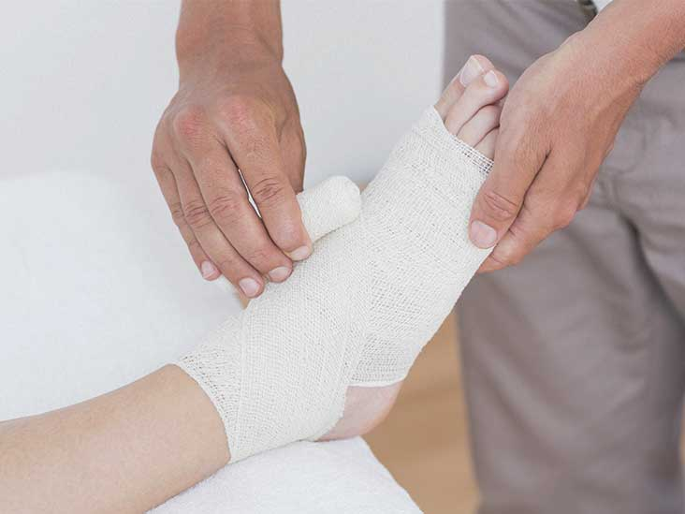
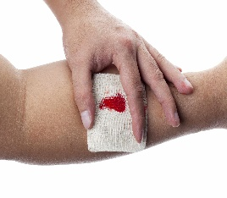
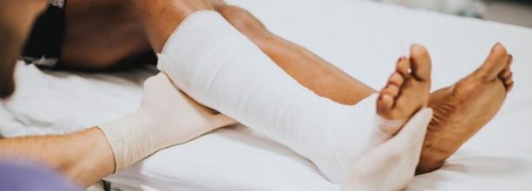
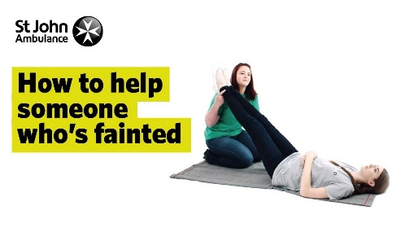
PROBLEM STATEMENT
The current competency level among people in most communities to administer first aid is inadequate.
Many lives are at stake and lost due to limited knowledge and luck of understanding on the concept of first aid. Therefore measures need to be taken to cover that gap. This is eminent and paramount to create awareness not only in theory but also practically by imparting those skills into individuals thereby reducing the gap and saving lives.
Training emphasis
CPR(Cardio pulmonary resuscitation) administration
Fractures –simple and compound
Electrocutions
Chocking
Burns and wounds
Fainting
Bleeding
Immobilization of the hurt
HOW THE LINK UP TEAM WILL BENEFIT
Through the save mobile we shall be able to earn through charging a fee to every individual who would like to train with us. In addition we shall mobilize primary schools, secondary schools, tertiary institutions.
Through the E-save, we will be able to make money through Ads and a 15% per payment of the bookings made.
Email marketing has always been and still is a powerful money-making strategy. We shall leverage this method and ask the users of these apps to provide their Emails and later send massages to them.

Slide 3
REVENUE STREAM
CATEGORY | GENTS | LADIES | P.W.D | ADMINISTRATORS
Primary Schools Secondary Schools | 500/= 1000/= | 500/= 1000/= | FREE | 10,000/=teachers
Colleges/ Institutions | 3500/= | 2000/= | FREE | 10,000/=
Hotel Chains | 10,000/= | 5,000/= | FREE | 15,000/=
Restaurants | 10,000/= | 5,000/= | FREE | 15,000/=
Local authorities | 10,000/= | 5,000/= | FREE | 15,000/=
Entertainment chains | 10,000/= | 5,000/= | FREE | 15,000/=
Corporate clients (NGOs) | 25,000/= | 15,000/= | FREE
Home outreaches | Negotiable |  | FREE | Not < 50,000/=
PROJECTION DURATION
The save mobile training and activities will start in six weeks’ time after putting together all necessary first aid equipment’s and materials.
We are currently working on the E-save web interaction digital booking platform to cut down the time for its implementation in the communities. We are hoping to have finished this projects in a period of 4 months.

Slide 4
PROJECT BUDGET
PROJECT BUDGET
ITEM | QUANTITY | UNIT COST(UGX) | TOTAL(UGX)
DEL LAPTOPS | 2 | 1,500,000 | 3,000,000
WEB HOSTING | 1 | 300,000 | 300,000
BUSINEES REGISTRATION | 2 | 400,000 | 800,000
FIRST AID EQUIPMENTS | Tent, whiteboard, Tables, Stretcher, First aid box |  | 3,600,000
MARKETING |  |  | 500,000
MISCELLANEOUS |  |  | 400,000
TOTAL |  |  | 8,800,000

